Slide 1
Stage 1 Revamp
Module content as of 26/09/24
Please note:
One slide per module
Each slide has a comment summarising main discussion points related to that module
Contact hours represented by e.g. "x1" (for 1hr) where this was discussed
Some practicals were proposed in the meeting and are included here – earlier practical suggestions are not
Content for Stage 2 or the "bin" included towards the end
Pictures of each module included on the last slide
Please don't add further comments here unless necessary – next steps are to identify module leaders who will finalise content, hours, practicals & assessments

Slide 2
Semester 1
Semester 2
Core Concepts in Biomedical Sciences
(20cr)
Molecules of Life
(20cr)
Cells to Systems
(20cr)
Infectious Disease and Emerging Health Challenges (20cr)
Therapeutic Mechanisms
(20cr)
Core Skills in Biomedical Sciences
(20cr)
Note: above names are working titles TBC

Slide 3
“Core concepts in biomedical sciences” (S1+S2)
Sem1:
Basic organic/inorganic chemistry
Cell structure (eukaryotic/prokaryotic/viral) “biodiversity”
Lipids and membranes
Cell division (mitosis/meiosis)
Cell cycle/replication/death
Cellular function and dysfunction
Central dogma
Sem2:
Ethics x1 (introduction)
Experimental models
Homeostasis x1-2 (acid-base, ANS+SNS)
Cell signalling
Genotype/phenotype
Genetics, genomes, heritability
(module content to “taper off” into Sem2)
Notes:
Discussion points:
- is cell function/dysfunction core content to be covered along with cell cycle?
- 1x ethics as in introduction but it to otherwise form an underpinning concept covered across stage 1?
- assessment; initial thoughts were 100% MCQ, then moved towards Sem1 MCQ + Sem2 SAQ

Slide 4
“Core skills in biomedical sciences” (S1+S2)
Sem1:
Ongoing group project
Statistics
Biomaths
Early teamwork – industry/workplace based problem based on a global health challenge. To involve data analysis and interpretation, use of Excel and light touch statistics.
Information retrieval, study skills, scientific reading/writing and resilience training (“self-efficacy”)
Sem2:
Ongoing group project – same/different groups? Coding (R/Python). Larger datasets (based on practical data?), drug development theme?
Scientific reading/writing.
Data visualisation, intermediate statistics (hypothesis testing).
(module content to “taper on” into Sem2)
Notes:
Discussion points:
- Title = it was felt “Core skills” is misrepresentative due to absence of practical skills, but “research” or “scientific” skills didn’t truly convey the content. “Foundations of Research” or “Fundamental Scientific Skills” were proposed but not agreed. Use of term “research” may be offputting to students, and exclusively referring to “scientific” skills undersells the transferable skill development in this module.
- Suggestion was to avoid going too data heavy in semester 1 - encourage teamwork skills and group work early, and develop resilience/self-efficacy
- Elements of global health, chronic and rare diseases should be covered in whatever form the projects in this module take, and underpinning ethics
- Simon Cockell mentioned that we should be wary of staff/resource availability to teach informatics etc to potentially 400 students - suggested that 5hrs was the upper limit of contact time for this based on current experiences and resource

Slide 5
“Molecules of life” (S1)
Biophysics – pH (water, thermodynamics, kinetics)
Nucleic acids (inc. mention of phosphorous structures), RNA/DNA, replication, transcription, translation
Gene expression (prokaryotic and eukaryotic)
Proteins and amino acids (stability/folding interactions)
Enzymes/enzyme kinetics
Molecular separations (associated practicals?)
Blood types – including genetic aspects
Carbohydrates and metabolism (bioenergetics, inc energy/phosphorous)
Recombinant DNA/expression systems (practical?)
Diabetes/obesity – example themes for molecules of life/emerging health challenges
Notes:
Discussion points:
- title of module was agreed as good. Needed to ensure content fit within the “molecules” definition.
- recombinant DNA/expression systems was suggested as also fitting in the “infectious disease/health challenges” (title TBC) module, possibly as a lab
- diabetes/obesity could also both be themes that underpin molecules of life/health challenges modules

Slide 6
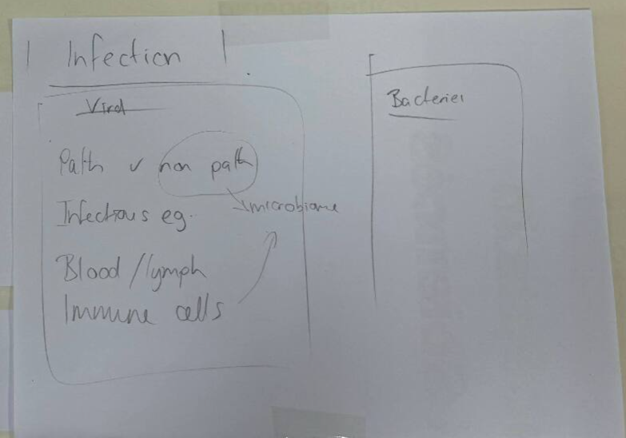
“Infectious disease and emerging health challenges” (S1)
Suggested themes: chronic disease, HIV/RSV, malaria, TB, asthma, infection, lifestyle, ageing
Epidemiology as an introduction?
Pathogenic vs non-pathogenic (organism structure)
Blood cells (and lymph system?)
Infectious disease – micro, viral, fungal, yeast
Immune system (innate, acquired, antibodies)
Microbiome
Possible structure:
Notes:
This module was probably the most discussed, with a feeling that both the title and structure needed work to more clearly align with one another.
Discussion points:
- title TBC - “global health challenges” conveyed too much of an epidemiological perspective that was maybe too much for stage 1, or undersold other aspects of the module content. “Infectious disease and emerging health challenges” became a more appropriate working title.
- to set the context of global health, do we need to have an introduction to epidemiology here?
- it was thought too much to try to cover a lot of original suggestions, e.g. COVID (maybe in 10 years time), HIV (been and gone) - in favour of the likes of RSV and malaria (more contemporary)
- microbiome needed to be covered but separated from the GI system
- recombinant DNA/expression systems and diabetes/obesity could be overlapping themes between this and the molecules of life module
- the rationale behind this module being Semester 1 was to introduce some interesting topic areas rather than Semester 1 content being entirely “fundamental subject knowledge”

Slide 7
“Cells to systems” (S2)
Developmental biology (basic principles, organogenesis, embryogenesis) x2-3
Cell-cell interaction (organisation into tissues) x2
Membrane transport (inc ion channels) x2
Specialised cells (epithelial, muscles, excitable cells and action potentials) x2-3
Cardiovascular system x4 (cardiovascular anatomy, cardiac cycle, ECG, basic control mechanisms)
Nervous system (basic anatomy, cellular connections, neuromuscular junction) x3-4?
GI system x2
Basic human anatomy to be covered in the above ^
Notes:
Discussion points:
- generally agreed the module title and content align well
- stem cells originally proposed alongside specialised cells here, but thought these could be introduced along with cell division in the core module, or with the developmental biology content?
- basic human anatomy should be included alongside the relevant system content rather than as a separate entity - but human anatomy should be considered as a stage 2 module (currently very well liked)
- possible labs: nerve conduction velocity, ECG

Slide 8
“Therapeutic mechanisms” (S2)
Genetic analysis of disease (SNPs, GWAS?) x1
Cancer basics (+ alternatives)
Cell signalling (recap), GPCRs as a drug target
Drug discovery and development (+ serendipity in side effects e.g. Viagra, metformin) + delivery
Drug toxicity and adverse drug reactions (+ renal?) x1
Pharmacodynamics/kinetics (ADME)
Antibiotics and AMR
Vaccine basics
Lifestyle interventions
Notes:
Discussion points:
- module name was discussed, originally Mechanisms to Medicines but it was felt this discounted content such as lifestyle interventions, so Therapeutic Mechanisms became the working title
- drug delivery wasn’t originally included but has been suggested

Slide 9
Content to go into stage 2
Drug elimination (does this need renal function knowledge?)
Kidney + liver
Respiratory system
Specific anatomy module
Toxins and overdose
Endocrinology
Inflammation/antihistamines (needs respiratory)
Basics of allergies (needs respiratory)
Gene editing/CRISPR
Notes:
- Note that the E in ADME represents elimination so we need to decide whether that is included in the Therapeutics module or not
- Kidney, liver and respiratory systems were felt more appropriate for stage 2, as was a dedicated anatomy module
- endocrinology was felt to be more suited to stage 2

Slide 10
“bin”
Phosphorous in biology
Origins of life (biodiversity)
Notes:
Note these aren’t truly “binned” concepts - it was felt phosphorous in biology could just be included when teaching DNA structure, and covered innately elsewhere in terms of phosphorylation
Biodiversity is mentioned in the RSB criteria but can be light touch, so is innately covered by for example discussing pathogenic vs non pathogenic organisms and more

Slide 11
Pictures

Slide 12
